Slide 1
Thank you for your willingness to work with a student teacher from Mayville State.
As you go through the PowerPoint please click on the audio icon on the bottom right hand side of each slide.

Slide 2
Orientation for Cooperating Teachers
Mayville State University

Slide 3
Welcome
Dr. Andrea Dulski-Bucholz
Division Chair & Assistant Professor
andrea.dulskibucholz@mayvillestate.edu
701-788-4833
Kayla Smith
Director of Student Placement and Data Management Coordinator
kayla.d.smith@mayvillestate.edu
701-788-4827

Slide 4
Overview Page
Conceptual Framework
Qualities & Requirements of a Cooperating Teacher
Role of Cooperating Teacher
Role of University Supervisor
Expectations for the Student Teacher
Preparation to be a Cooperating Teacher
Student Teacher Orientation
Suggested Timeframe
Forms to Complete
Information Processes

Slide 5
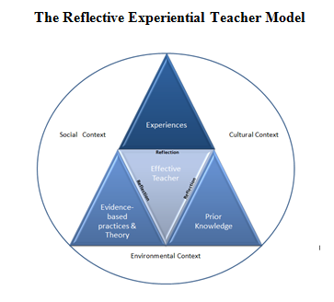
Conceptual Framework

Slide 6
Qualities of a Cooperating Teacher
3 years of teaching experience with 1 year in current school district
Effective Communication
Demonstrates teaching excellence
Lifelong learner
Respected member of the community

Slide 7
Preparation to be a Cooperating Teacher
Have you ….
thought about your own goals for the experience?
reflected on your skills and strengths?
discussed this endeavor with colleagues who have been a cooperating teacher?
thought about how you will work with the student teacher to plan instruction and share instructional time?
thought about how you will provide critical feedback to the student teacher?

Slide 8
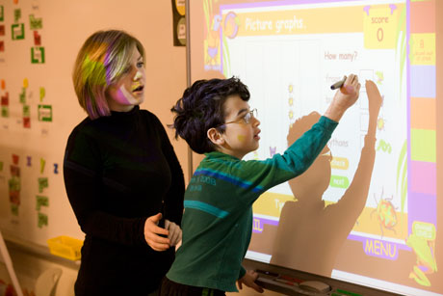
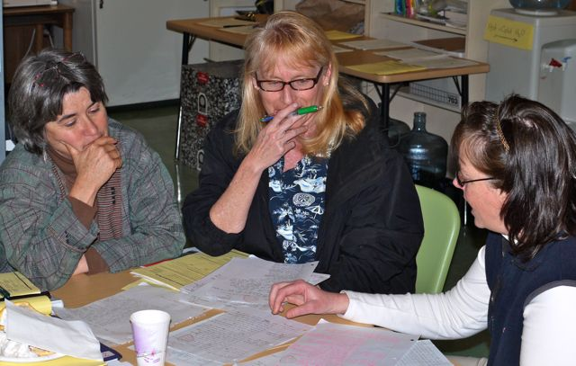
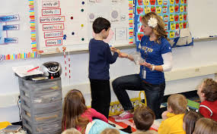
Role of Cooperating Teacher

Slide 9
Role of University Supervisor
Cooperating Teacher
University Supervisor
Director of Student Placement
Division Chair

Slide 10
Expectations of the Student Teacher
Dress, behave, and communicate in a responsible, professional manner
Demonstrate professionalism in fulfilling scheduled student teaching experience hours
Take initiative to assist in the classroom at all times
Demonstrate an eagerness to learn and take initiative
Attend all professional meetings at school and at the university
Seek and implement advice to improve developing practices

Slide 11
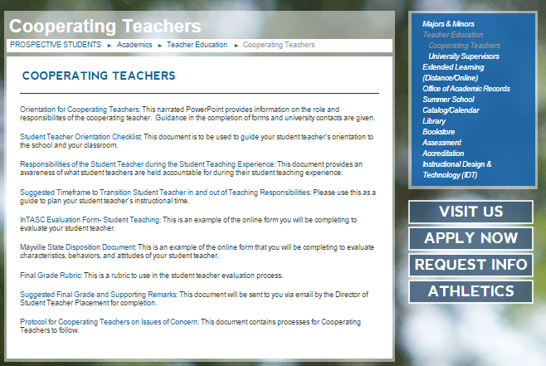
Student Teacher Orientation

Slide 12
Timeframe for Phasing Student Teacher
into F-T Teaching
Weeks
1-15 1-10 1-5 7-8
 |  |  | F | F | F | F | F
 |  | P |  |  |  |  |  | P
 | P |  |  |  |  |  |  |  | P
0 |  |  |  |  |  |  |  |  |  | 0
Part-Time Classroom
Instruction
Observation

Slide 13
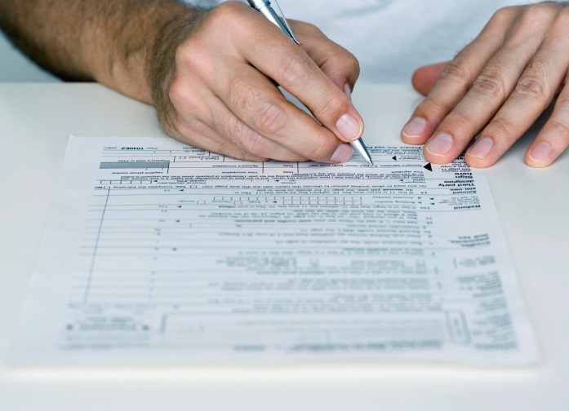
Forms to Complete
and how to complete them
kayla.d.smith@mayvillestate.edu

Slide 14
Verification of Orientation
To verify that you have completed this orientation please email Kayla Smith at kayla.d.smith@mayvillestate.edu.
In this email indicate:
The date you viewed the orientation.
If you would like Mayville State University to send you a certificate of completion.
Any further questions that you may have about your roles and responsibilities as a cooperating teacher.

Slide 15
Thank You !

